Slide 1


HOW TO USE COMSOL ?
Simon Schmit, July 2025

Slide 2
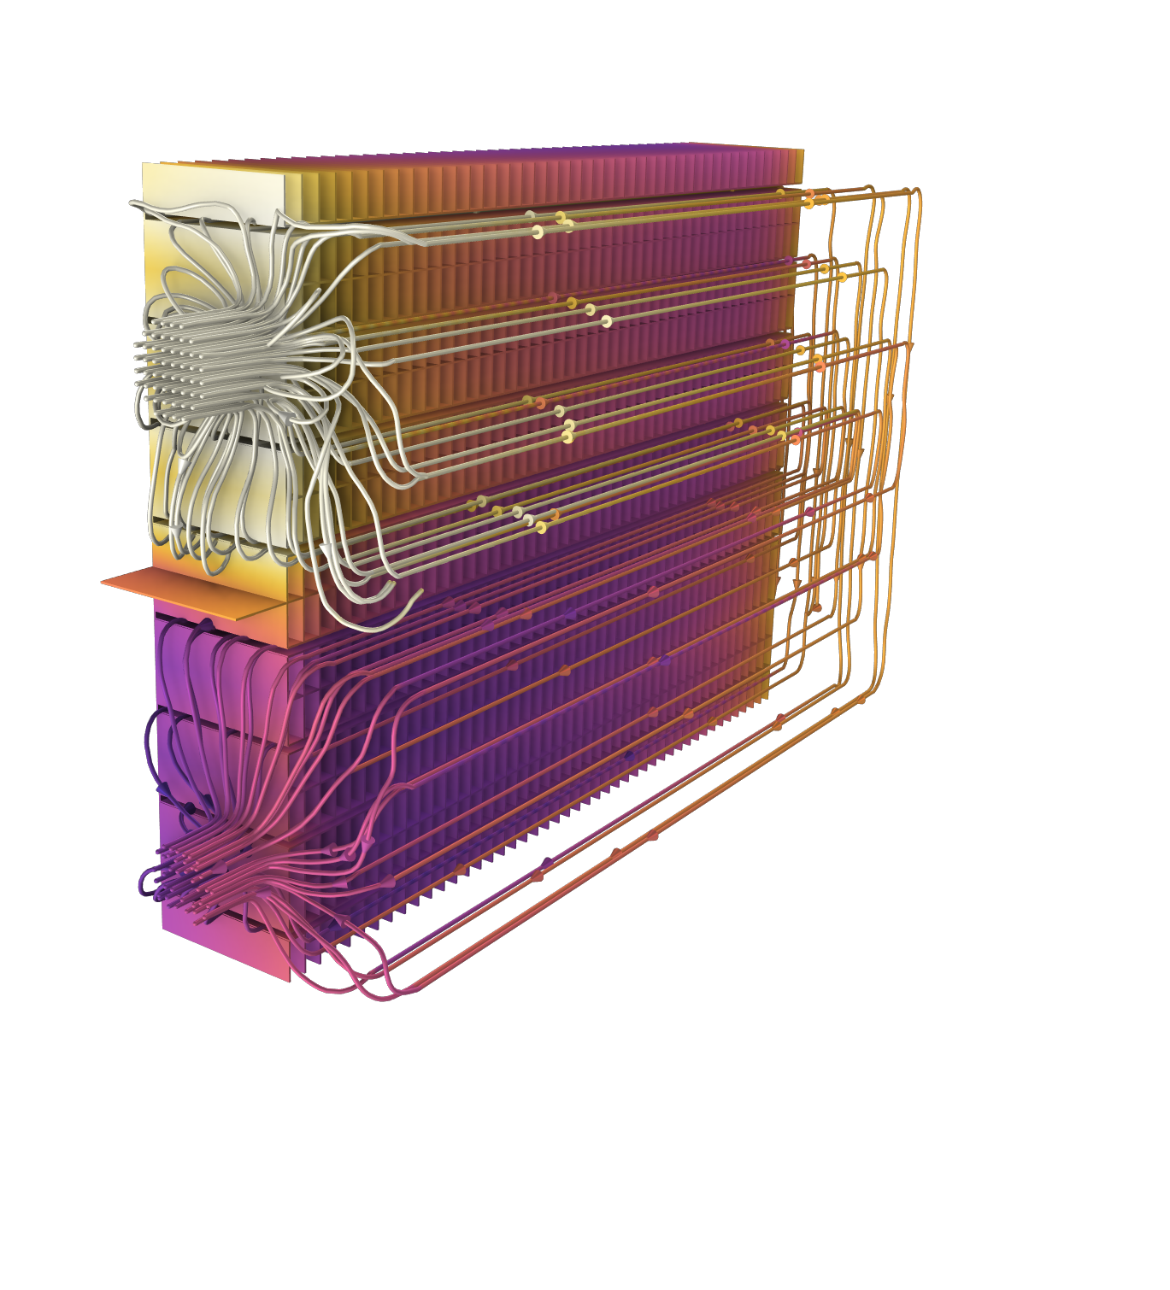
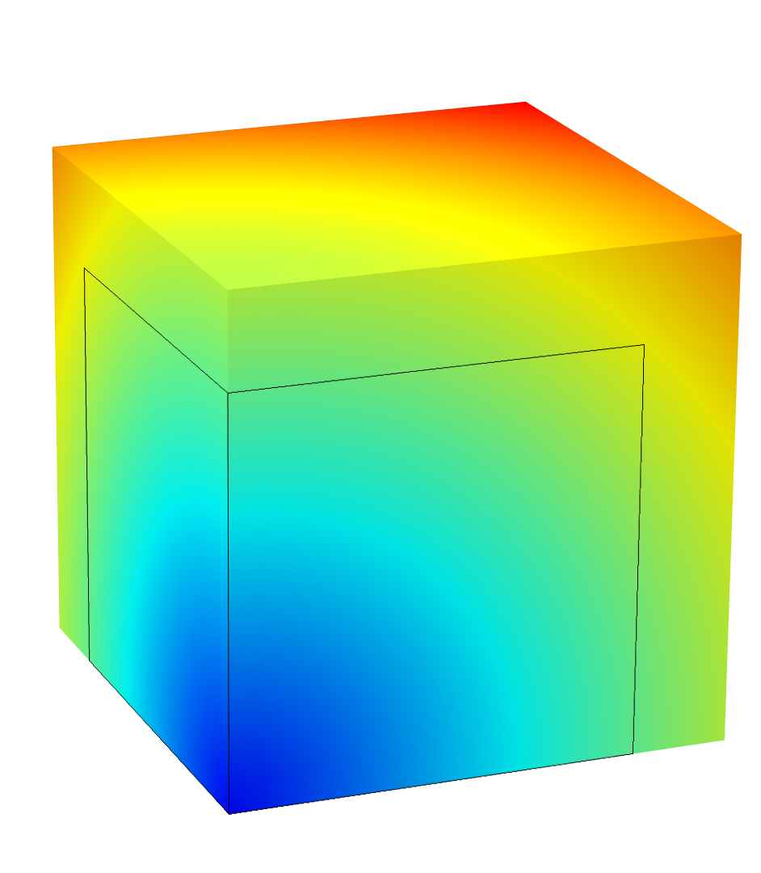
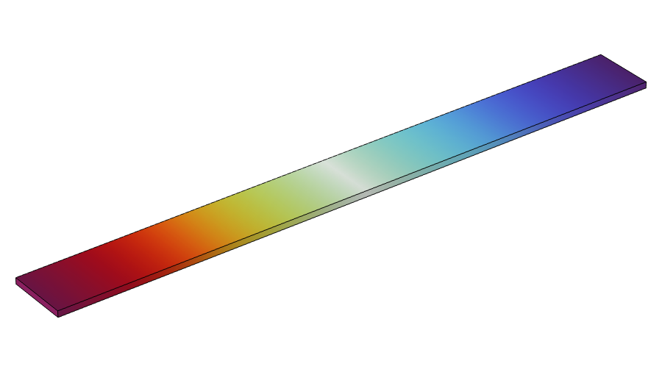
Steps
Parameters
Definitions
Geometry
Materials
Physics
Mesh
Time study settings
Extracting data/results

Slide 3
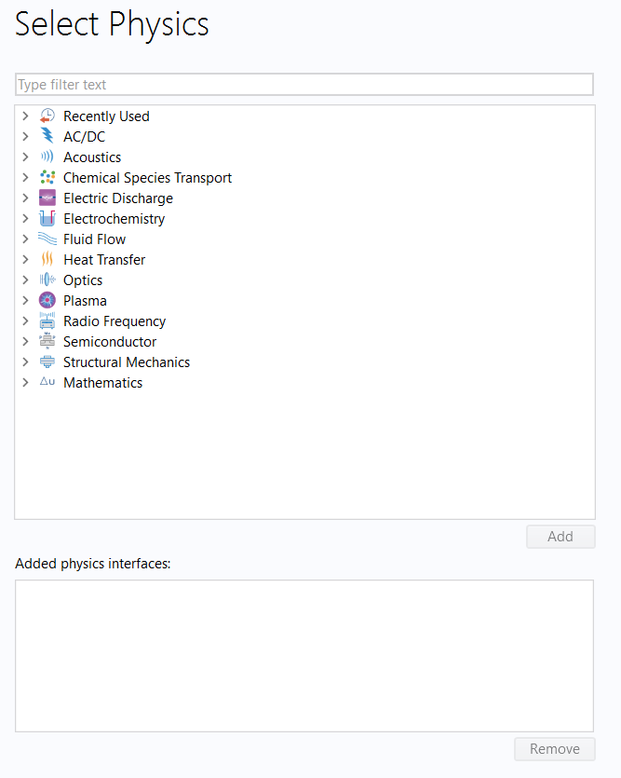
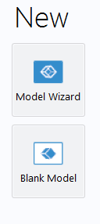
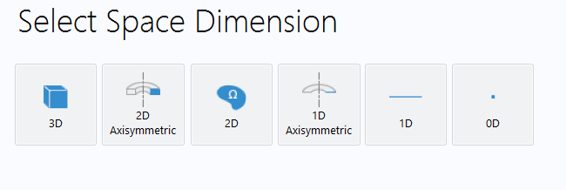
Creation of the file

Slide 4
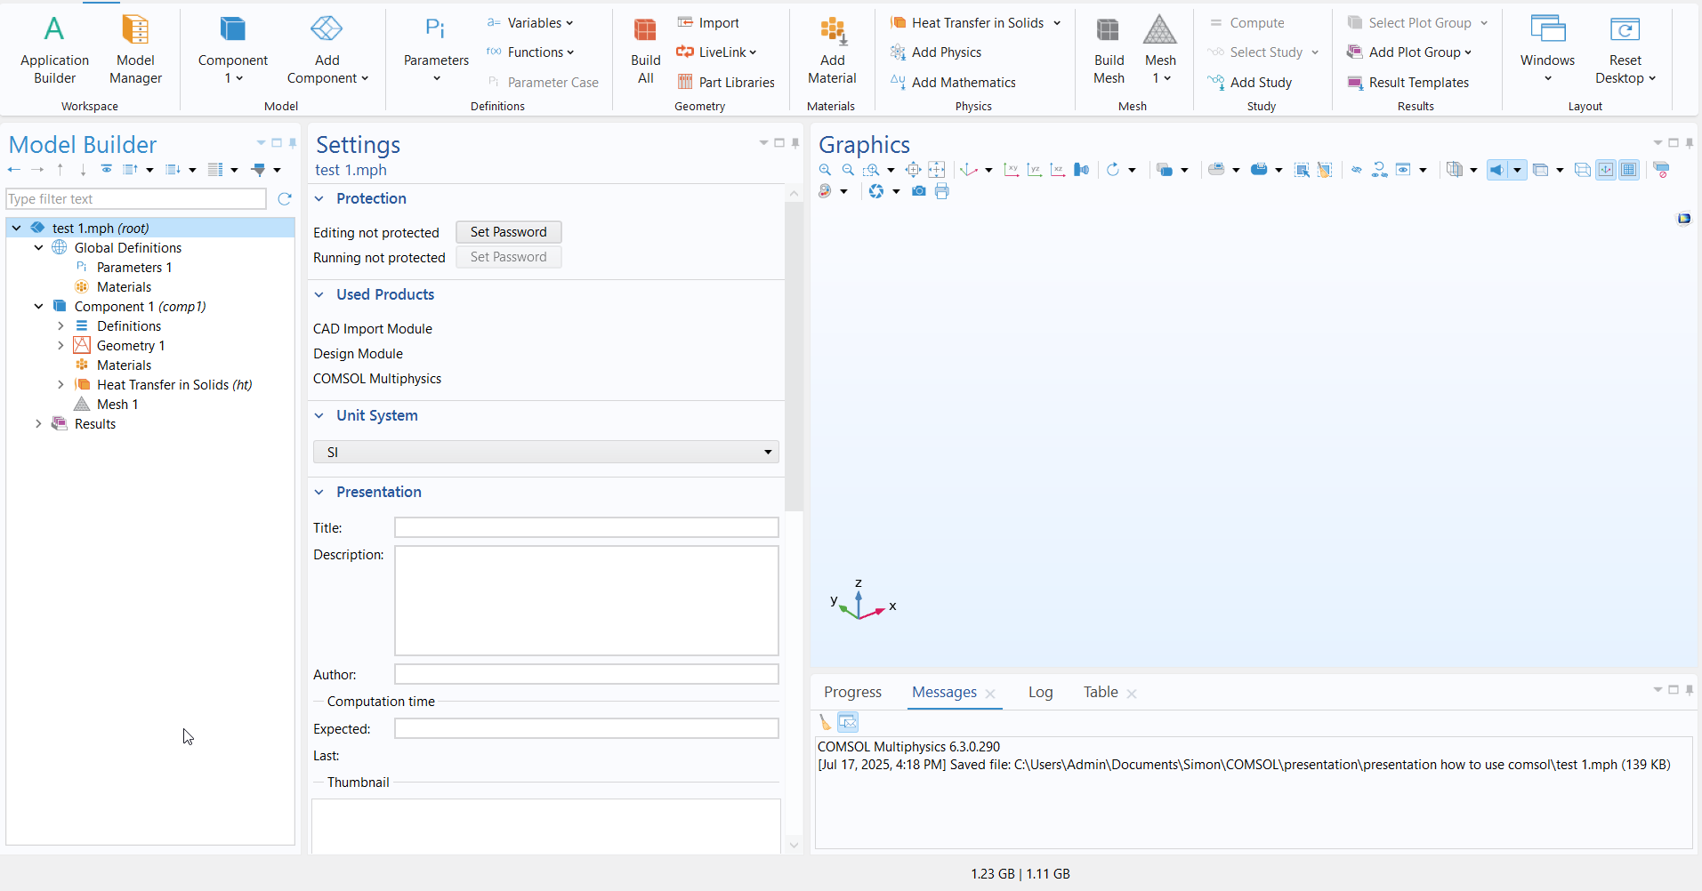
Main interface
Visualising the geometry or the results
Selecting the module to add/delete or to interact with
Specifying the parameters to change

Slide 5
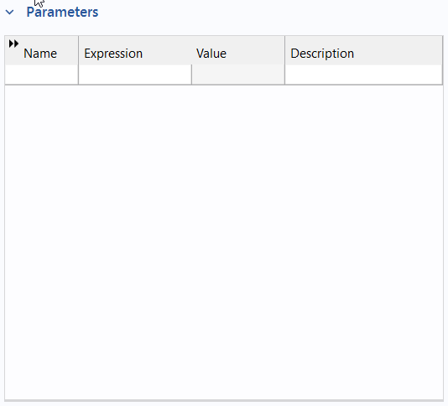
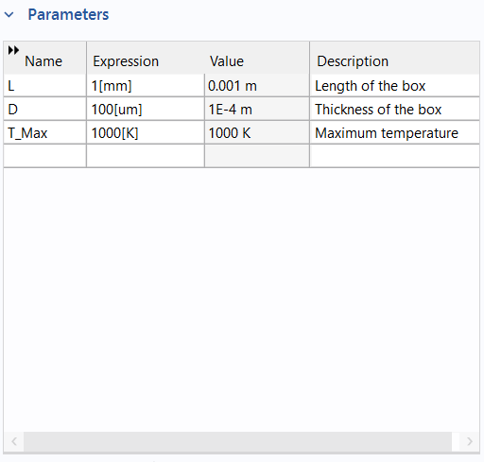
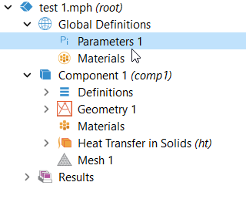
1/ Defining parameters

Slide 6
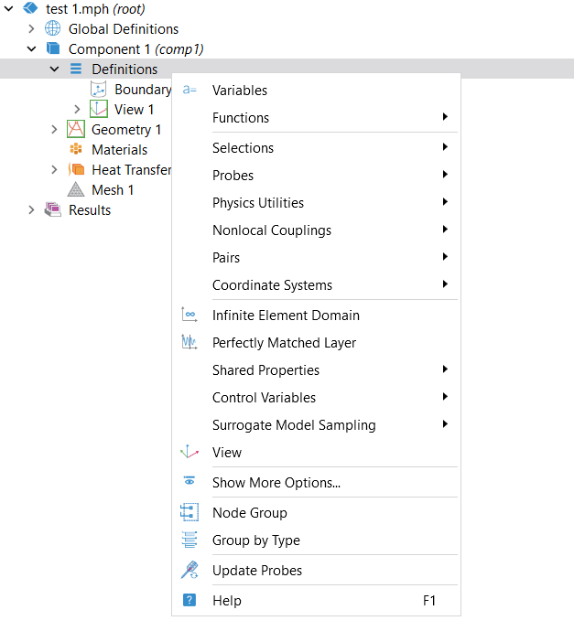
2/ Definitions
Creating callable expression (ex: heat input)
Defining functions (all types)
Specifying points/surface/volume to study

Slide 7
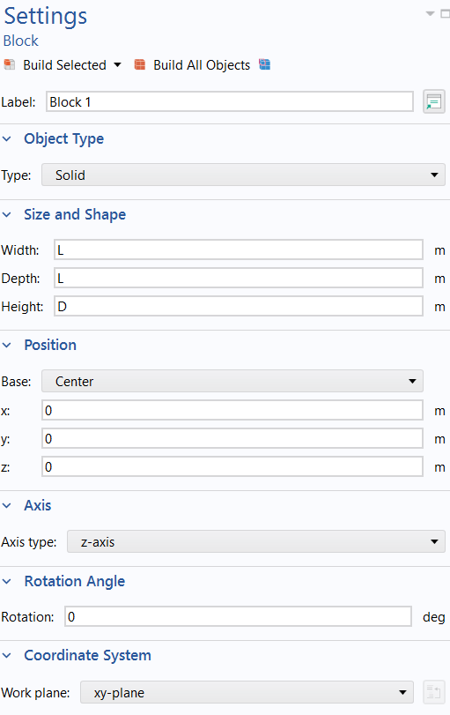
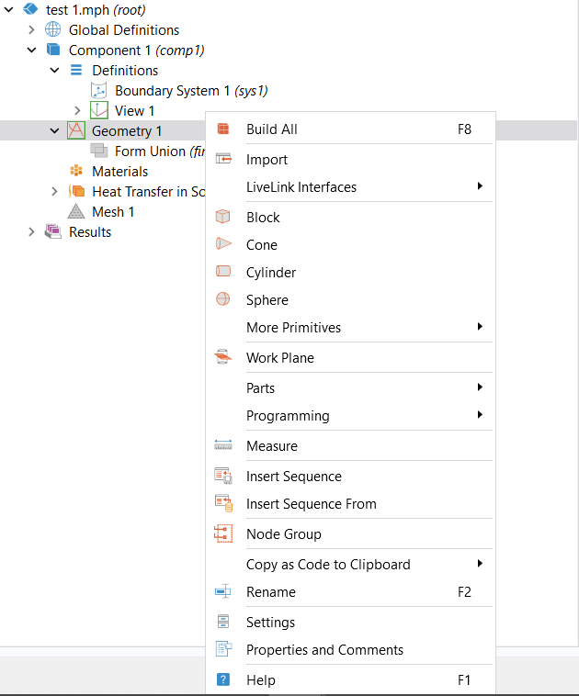
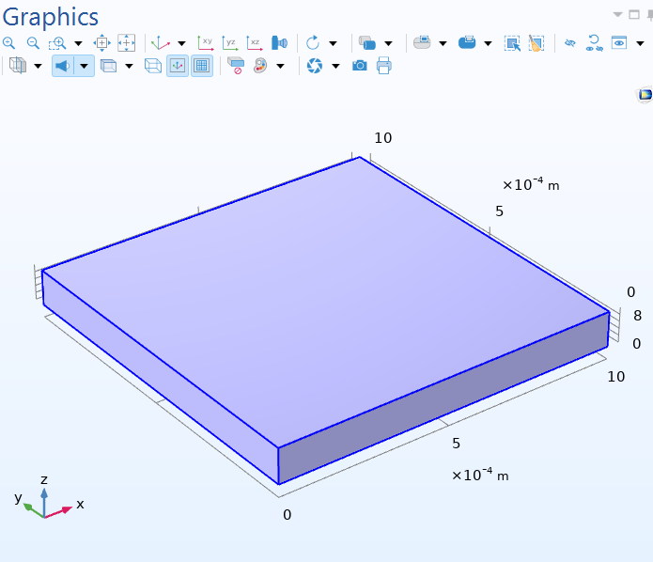
3/ Geometry
Creates a 2D plane to add 2D geometries on 3D things

Slide 8
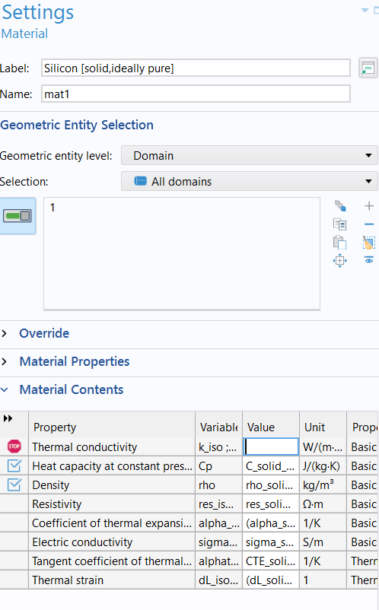
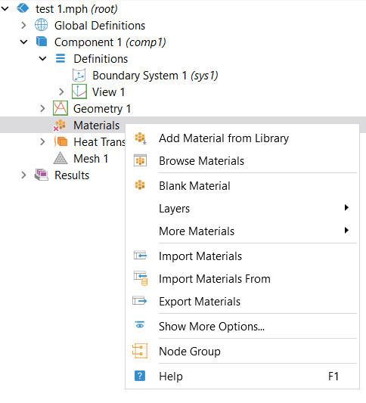
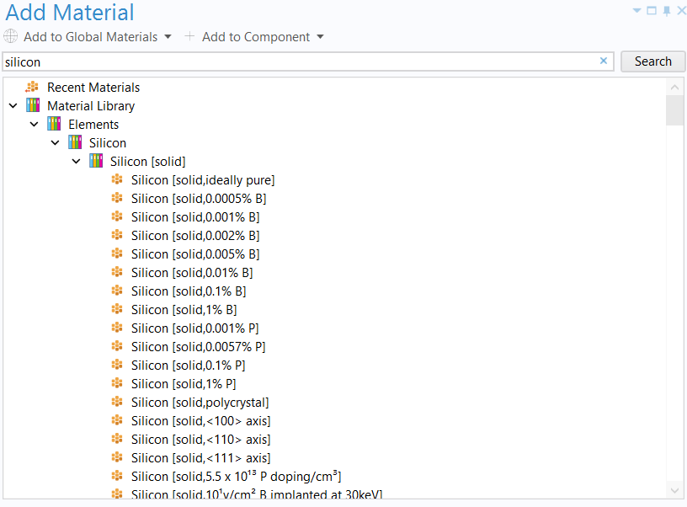
4/ Materials (first way)

Slide 9
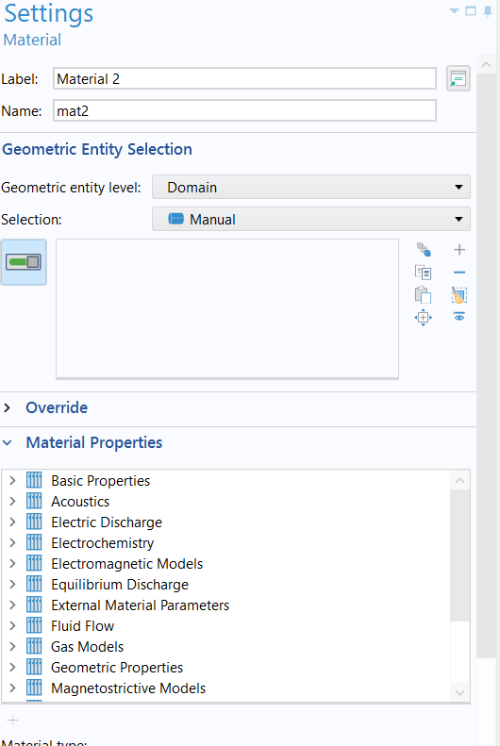
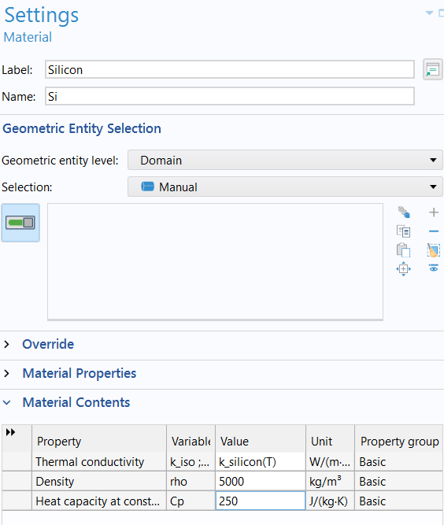
4/ Materials (second way)

Slide 10
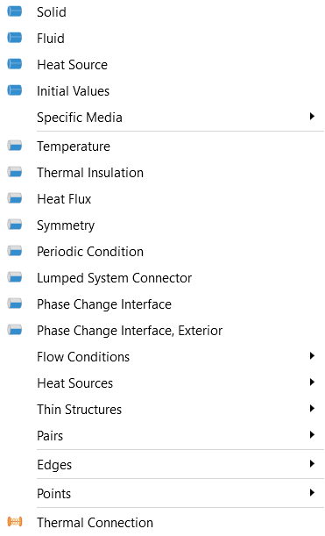
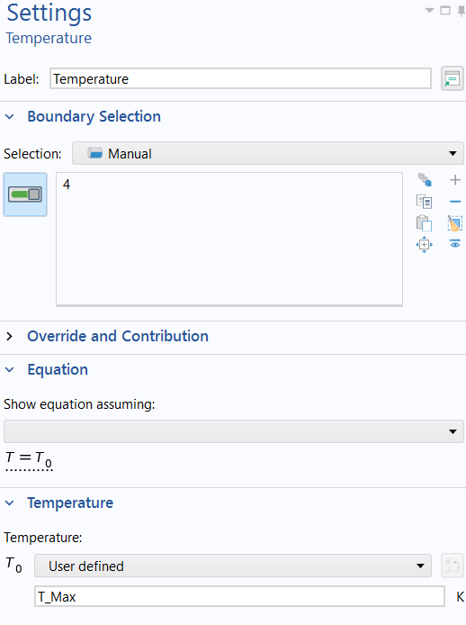
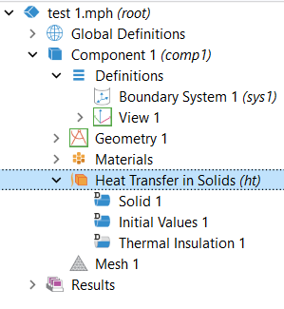
5/ Adding physics

Slide 11
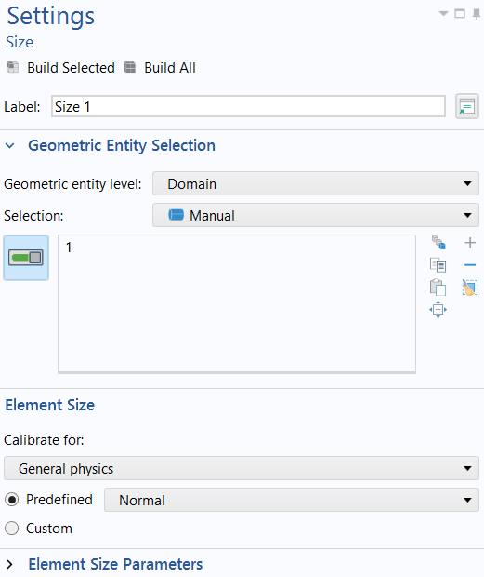

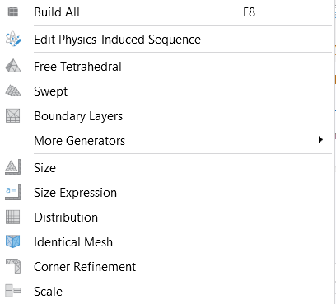
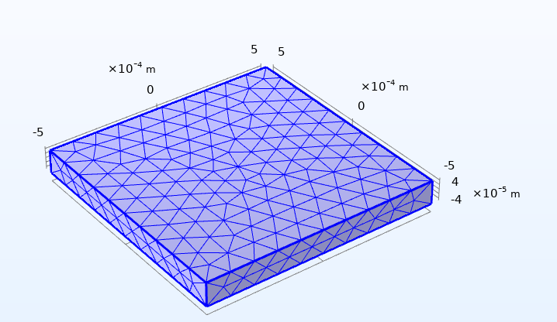
6/ Creating Mesh (first way)

Slide 12
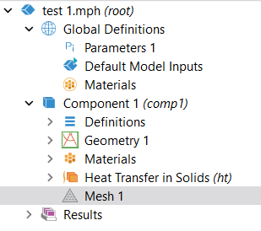
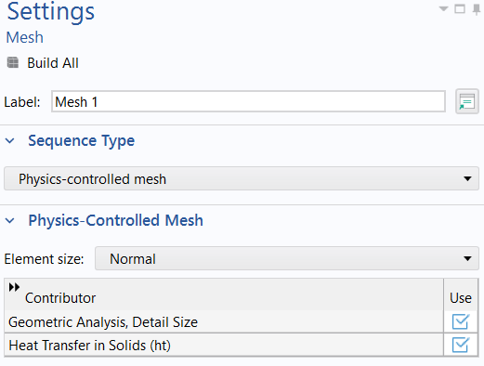
6/ Creating Mesh (second way)

Slide 13
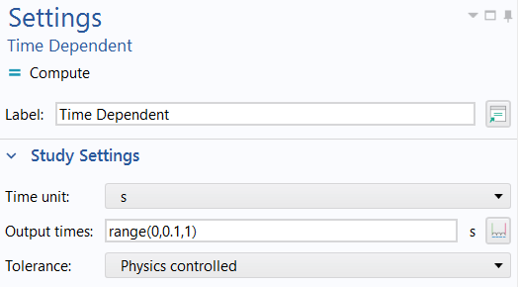
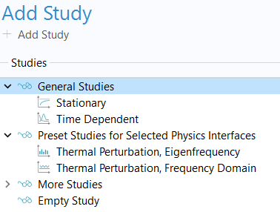
7/ Add a study (time dependent)

Slide 14
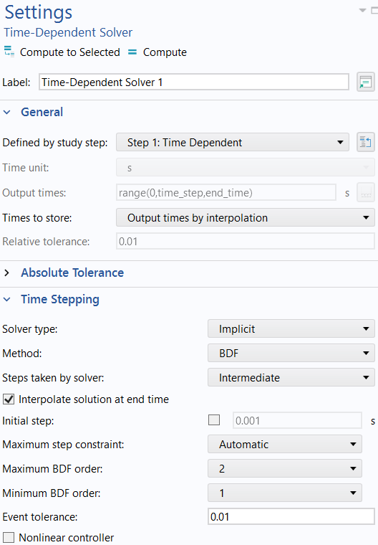
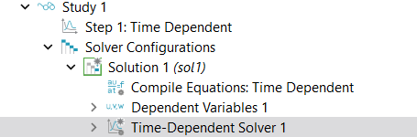
7/ Add a study (time stepping of the study)
Choose « intermediate » for a better precision. It makes more measures in more dynamics times.

Slide 15
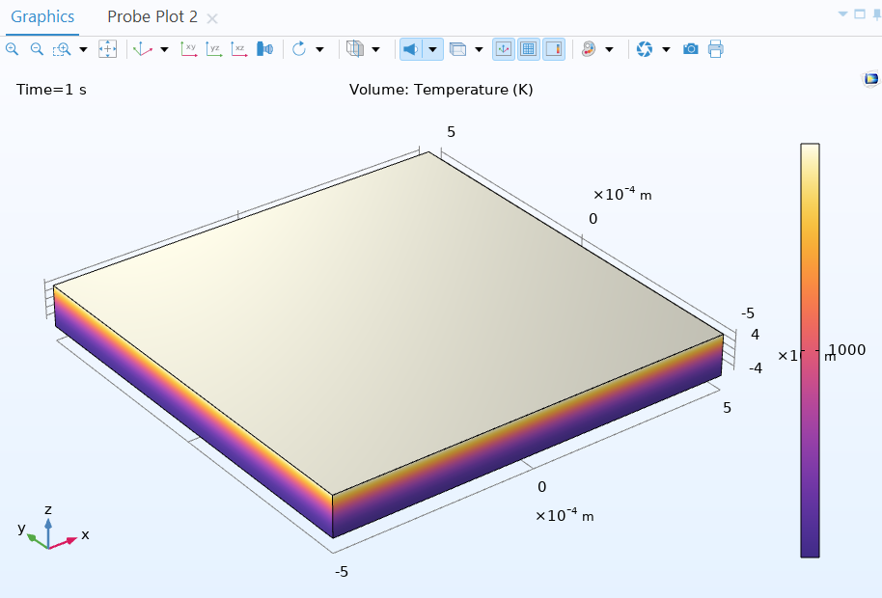
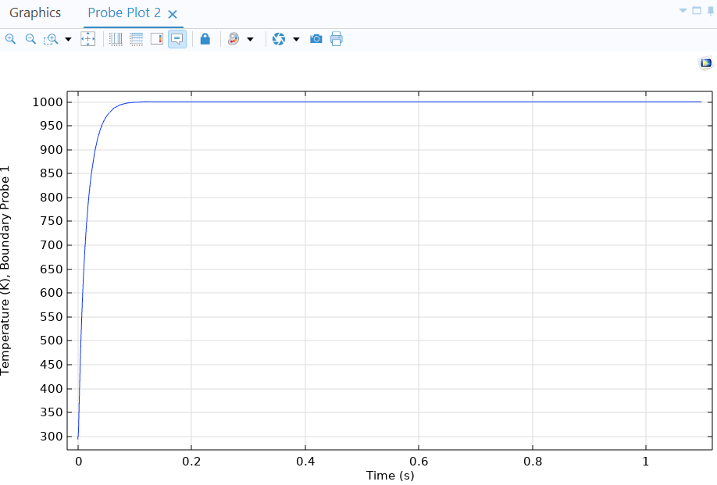
7/ Results

Slide 16
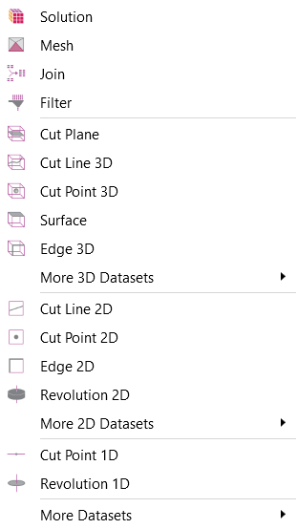
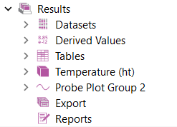
7/ Results (extracting data 1/2)
Defines a 2D plan in your geometry (ex: slice of a box)
Defines a 1D line (ex: depth of the box at x and y fixed)
Defines a point (ex: the middle of the top surface of a box) v

Slide 17
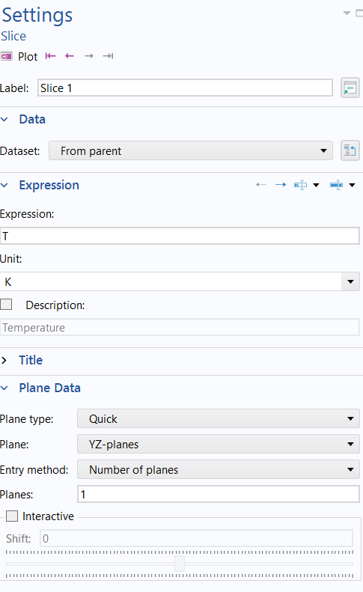

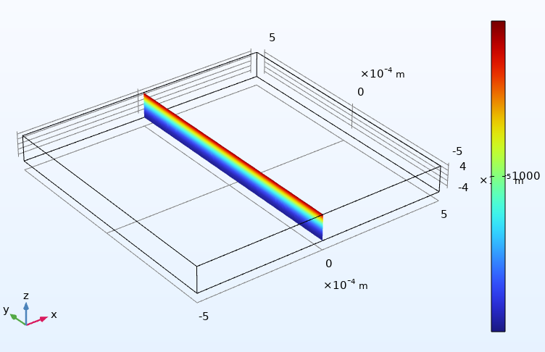
7/ Results (extracting data 2/2)
Slice direction
Number of slices

